Slide 1
Open Group Service Integration Maturity Model (OSIMM)
Launch presentation and notes from first Working Group 1.2.07

Slide 2
WG Updates – San Diego 2/1/07
Actions
  Reviewed current submission baseline
  Discussed elements of model that need evolving.
  Addressed initial impressions.
WG discussed the validity
  Dimensions
  Levels

Slide 3
WG Updates – Model discussion
Dimensions
  General impression that current model was accurate
    Group agreed that service orientation does not start until level 4 – model should point that out.
  The WG consensus was that the Organization component should be renamed to Organization & Governance.
  Alex strongly suggested to include management as separate from infrastructure.
    Lengthy discussion of the meaning of infrastructure and how it may relate to management.
    Still need flush out what the management maturity characteristics
  Updated Model follows

Slide 4

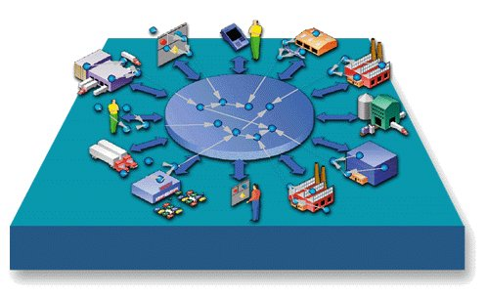


Open Group Service Integration Maturity Model – Matrix 2.1.07
Service Foundation Levels
Dynamically
Re-Configurable
Services
Composite
Services
Virtualized
Services
Silo
Integrated
Componentized
Services
Business View
Function
Oriented
Function
Oriented
Function
Oriented
Service
Oriented
Service
Oriented
Service
Oriented
Service
Oriented
Governance & Organization
Application Specific Skills
IT Transformation
IT Governance
Technology Adoption
Organizational Transformation
Cultural & behavioral Transformation
Human Service Bus
Methods
Structured Analysis & Design
Object Oriented
Modeling
Component Based Development
Service Oriented
Modeling
Service Oriented
Modeling
Service Oriented
Modeling
Grammar Oriented
Modeling
Applications
Modules
Objects
Components
Services
Process Integration via Services
Process Integration via Services
Dynamic Application Assembly
Architecture
Monolithic Architecture
Layered Architecture
Component
Architecture
Emerging
SOA
SOA
Grid Enabled SOA
Dynamically Re-Configurable Architecture
Information
Application specific data solution
Data Subject Areas established
Business Data can be shared outside the Silo.
LOB wide standardized Data vocabularies
Enterprise wide standardized Data vocabularies
Flexible Data vocabularies for expansion
Data vocabularies are Standards based
Infrastructure
Platform
Specific
Platform
Specific
Platform
Specific
Platform
Specific
Platform
Independent
Technology Neutral
Dynamic
Sense &
Respond
Level 1
Level 2
Level 3
Level 4
Level 5
Level 6
Level 7

Slide 5
Open Group Service Integration Maturity Model – Matrix 2.1.07 – w/Management
Service Foundation Levels
Silo
Integrated
Componentized
Services
Composite
Services
Dynamically
Re-Configurable
Services
Virtualized
Services
Business View
Function
Oriented
Function
Oriented
Function
Oriented
Service
Oriented
Service
Oriented
Service
Oriented
Service
Oriented
Governance & Organization
Application Specific Skills
IT Transformation
IT Governance
Technology Adoption
Organizational Transformation
Cultural & behavioral Transformation
Human Service Bus
Methods
Structured Analysis & Design
Object Oriented
Modeling
Component Based Development
Service Oriented
Modeling
Service Oriented
Modeling
Service Oriented
Modeling
Grammar Oriented
Modeling
Applications
Modules
Objects
Components
Services
Process Integration via Services
Process Integration via Services
Dynamic Application Assembly
Architecture
Monolithic Architecture
Layered Architecture
Component
Architecture
Emerging
SOA
SOA
Grid Enabled SOA
Dynamically Re-Configurable Architecture
Information
Application specific data solution
Data Subject Areas established
Business Data can be shared outside the Silo.
LOB wide standardized Data vocabularies
Enterprise wide standardized Data vocabularies
Flexible Data vocabularies for expansion
Data vocabularies are Standards based
Infrastructure
Platform
Specific
Platform
Specific
Platform
Specific
Platform
Specific
Platform
Independent
Technology Neutral
Dynamic
Sense &
Respond
Management
Application
Specific
Platform
Specific
Platform
Specific
Service
Specific
Service
Independent
Virtualized
Dynamic
Sense &
Respond
Level 1
Level 2
Level 3
Level 4
Level 5
Level 6
Level 7

Slide 6
Launch Presenters
The Open Group – Bill Bateman, James de Raeve, Dr. Chris Harding, Allen Brown (CEO)
IBM – Ali Arsenjani (in our thoughts), Andras Szakal
Capgemini – Henry Hendrikx
Chris Moyer of EDS
Steve Wolf – Marriott
HP – Alex Heublien
Regis, Inc – Jack Fujieda
Others …

Slide 7
What if...
Businesses adopting SOA could assess their SOA maturity levels to accelerate their transformation?
SOA vendors could more rigorously demonstrate how their solutions help transform an organization towards greater maturity in SOA?
SOA architects had an maturity model, adoption and transformation guidance to shape the architectural strategy for SOA transformation across multiple dimensions?

Slide 8
What Are We Announcing
Standardization of the Open Group Service Integration Maturity Model (OSIMM)
  Provides ability to assess
    Current maturity
    Determine and design path to Future desired maturity
  Across 7 dimensions (business down to infrastructure)
  Applicable from pre-SOA, to currently established SOA projects through future horizon directions
The industry’s first collaborative maturity model for providing guidance on SOA adoption, transformation and maturity
Spearheaded by members of The Open Group, including IBM, BEA, HP, EDS, Capgemini and other members of the SOA Working group
First version of The Open Group Service Integration Maturity Model technical paper available Jan 2007 seeded by IBM GBS
  Based on numerous service engagement experiences

Slide 9


Open Group Service Integration Maturity Model (OSIMM)
Establish . . . An industry leading SOA and integration maturity model
Establish . . . Benchmarks and criteria for measuring SOA maturity
Leverage . . . Experience of leading practitioners

Slide 10
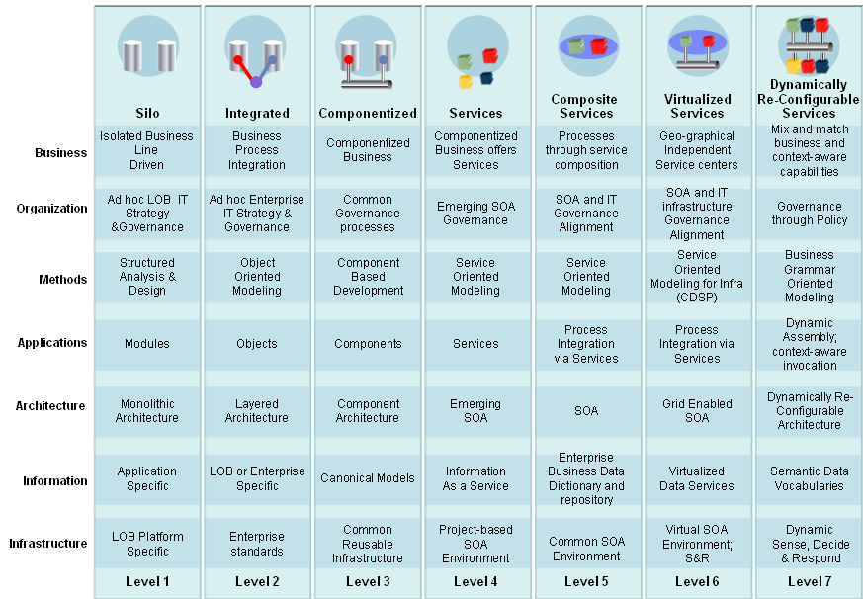
OSIMM Overview

Slide 11
The Open Group
The Open Group is a vendor-and technology-neutral consortium, whose vision of Boundaryless Information Flow™ will enable access to integrated information within and between enterprises based on open standards and global interoperability. The Open Group works with customers, suppliers, consortia and other standard bodies to:
  Develop open industry IT standards
  Capture, understand and address current and emerging requirements, establish policies and share best practices
  Facilitate interoperability, develop consensus, and evolve and integrate specifications and open source technologies
  Offer a comprehensive set of services to enhance the operational efficiency of consortia
  Operate the industry’s premier certification service
More information: www.opengroup.org/overview/what-we-do.htm

Slide 12
TOG Mission Vision
What is Boundaryless Information Flow™?
Boundaryless Information Flow, a shorthand representation of “access to integrated information to support business process improvements” represents a desired state of an enterprise’s infrastructure and is specific to the business needs of the organization.
An infrastructure that provides Boundaryless Information Flow has open standard components that provide services in a customer's extended enterprise that:
  Combine multiple sources of information
  Securely deliver the information whenever and wherever it is needed, in the right context for the people or systems using that information.

Slide 13
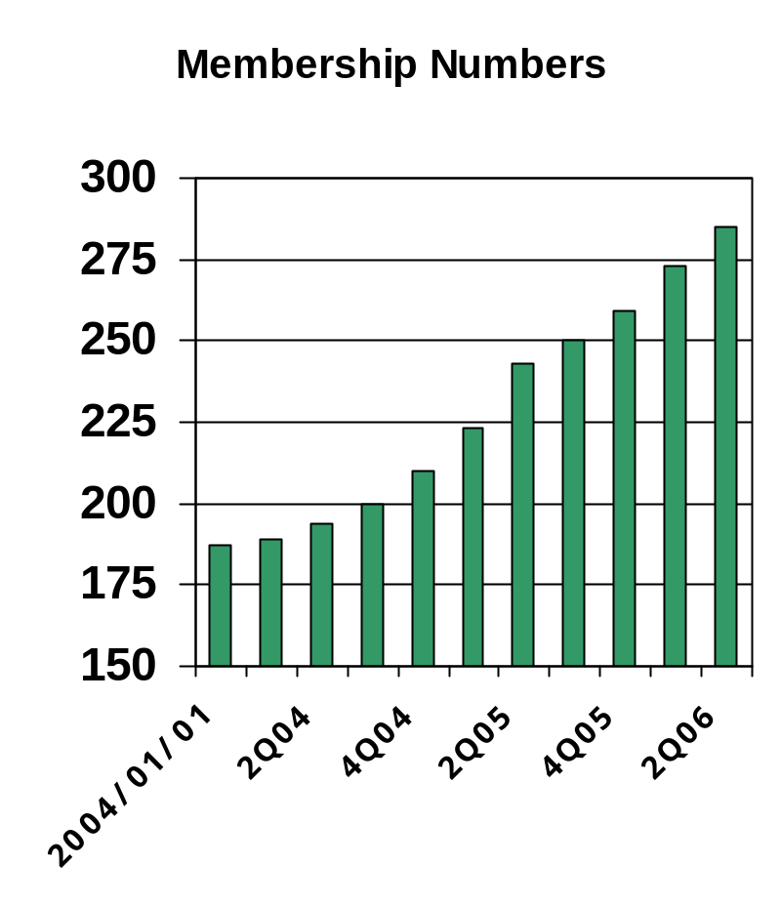
Open Group Members
Platinum (Top Tier) Sponsors
EDS
IBM
Fujitsu
Hitachi
HP
CapGemini
NEC
Key Areas of Growth
Architecture Forum (TOGAF, ITAC)
Jericho Forum (Security)
Real-time and Embedded Systems Forum
Governing Board
Platinum Members
Supplier Council (BEA)
Customer Council
Note: 1 company = 1 member
Full member list: www.opengroup.org/overview/members/membership_list.htm

Slide 14
Why The Open Group
The Open Group's membership, made up from large customer organizations, vendors and smaller consultants, reacted very positively to the proposal within the TOG SOA Working Group.
Other organizations have shown interest in this issue, but none has attracted the breadth of participation and completeness in scope that we see in The Open Group.
The proven record of The Open Group in developing methods and best practices adds significantly to the viability of the proposal.

Slide 15
Benefits for the Industry
“This unified industry view of SOA maturity will provide enterprises with a consistent model and terminology that will help advance SOA adoption within their organizations.” - Dr. Chris Harding, forum director for SOA and semantic interoperability at The Open Group.
“We are committed to creating standards such as the Open Group Service Integration Maturity Model that will help our clients to benefit more and more from SOA.” - Ron Tolido, Chief Technology Officer, Capgemini Continental Europe and Asia Pacific.
“The Open Group Service Integration Maturity Model will help companies create a roadmap for their transformation journey to SOA and better enable vendors to deliver services and software in line with increasingly well-established benchmarks.” – Dr. Ali Arsanjani, Chief Architect, SOA Center of Excellence, IBM

Slide 16
Future Goals/Directions
Establish OSIMM working group – 12/06
Publish first OSIMM public draft – 2/07
Public review of OSIMM 2.0 begins – 2/07
Working group collects public reviews and applies suggested changes– 3/07
Company review period begins – 3/07 (2 weeks)
Board ratification of OSIMM 2.0 standard – 4/07

Slide 17
What Are We Announcing: Review
Standardization of the Open Group Service Integration Maturity Model (OSIMM)
Industry’s first collaborative maturity model for SOA adoption, transformation and maturity.
For more information:
  www.opengroup.org/overview/
  www.opengroup.org/projects/osimm/

Slide 18


